Slide 1
Background
Number of pupils on roll – 1159 Number of FSM pupils - 261 Number of ALN pupils - 537 Number of pupils living in an area of deprivation - 276

Slide 2
Survey Process
6 x ICT suites Years 7, 8 and 9 – ICT lesson
Year 10, 11, 12 & 13 – WBQ lesson Teacher provided with class register and identified absent pupils Staff fully supportive End result – What we found out was what we thought.
Notes:
Visual representation.
Clear to see areas on where we need to focus.
Confirmed what we thought.
A working document which will be used and referred to as opposed to stored away.
Plan to survey again to once actions/changes have been made.

Slide 3
Current school (Pembroke School)
Open site and large in size. Public through road – Leisure Centre, Garden Centre and Care Home. The school has numerous entrance/exits (approx. 38) Years 10/11 Smoking Culture
Notes:
Years 10 and 11 – Smoking social culture

Slide 4
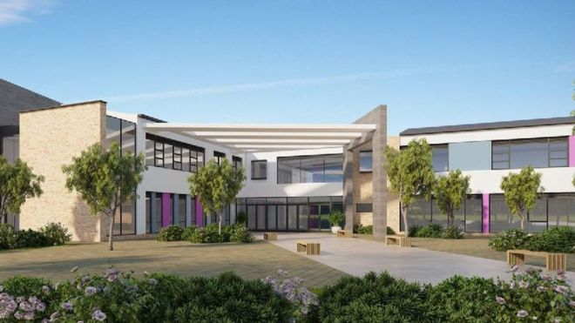
New School (Ysgol Harri Tudur/Henry Tudor School)
Enclosed site Change in Ethos Restricted entrance and exit points
Notes:
Enclosed school site with a much improved environment.
There is a change in ethos - The school has a new recently appointed head mistress with a new vision.
Intervention strategies are planned to support pupils along with an alternative curriculum which is currently being developed.
Parent workshops – Ysgol Harri Tudur/Henry Tudor School wishes to improve engagement with the local community.

Slide 5
Change in Culture (Staff)
Training ACE’s Awareness Attachment Awareness Pupil Passport Pivotal Training Next step Vertical mentoring
House system
Notes:
Connectivity - Improving relationships with pupils.
Next step – help support anti-bullying strategy and improve well-being

Slide 6
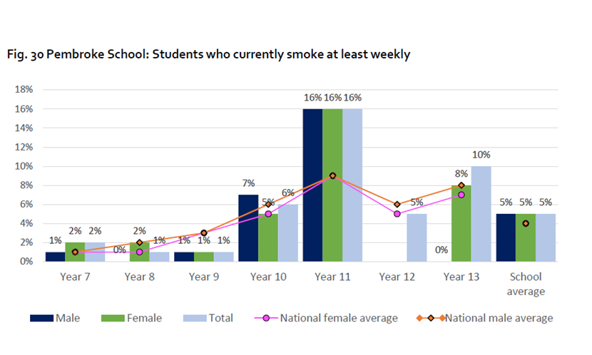
Report findings
Notes:
Clearly confirmed what we thought.

Slide 7
INTERVENTION PLAN
Support session offered for targeted group of year 10 pupils in July with follow up in September Support session offered for whole school population in July with follow up in September Parent/carer workshops will be made available in the new year

Slide 8
Other considerations
Adverse Childhood Experiences Study, Public Health Wales, 2015
‘School connectedness’
Reframe the issue/behaviour and address root cause

Slide 9
The building blocks of resilience
Equipped to manage your behaviour and emotions
Feel you can overcome hardship and guide your destiny
Grounded in cultural traditions ‘Connected’
One or more stable, caring child-adult relationship

Slide 10
FEEDER PRIMARY School
700 Pupils
Full day - 13th September 2018 with every class
W/C 17th September - Daily ‘Warm up’ for parents/carers smoking cessation support
28th September - Pre-quit Day
1st October - Quit Day ‘Stoptober’
7 x support sessions to follow up to 7th December

Slide 11
Who’s been involved?
Head of PSE
Assistant Headteacher Pembroke School
Healthy Schools Coordinator
Pharmacist
Smoking Cessation Advisors
Headteacher Feeder Primary School
Other agencies as required

Slide 12
THANK YOU FOR LISTENING. ANY QUESTIONS?

