Slide 1
St Richard Gwyn Catholic High School Flintshire
Mike Hughes
Health and Wellbeing Coordinator
@WellbeingSRG

Slide 2
Back to 2016...our Initial Action Plan
Immediate action points – sexting, legal highs and contraceptive use.
A number of strategies were looked at – reintroduce SRE into the PSE programme, modification of Health Days, close work with Flintshire’s Substance Misuse Action Team (SMAT).
Summer term – in depth meeting with SLT was planned and full action plan was to be completed.
Inspection….praised by Estyn – “great to see an approach to change driven by real data.”
However….SRG is put into Special Measures…not because of Health and Wellbeing!

Slide 3
Forward to 2017/18….
Autumn 2017 school was removed from special measures in record time...
New Headteacher recognises value of SHRN and we undertake questionnaire with over 90% of students completing.
School is in final stage of Phase 4 of Healthy Schools Award.
Report released by SHRN to schools…
But what do we do now?

Slide 4
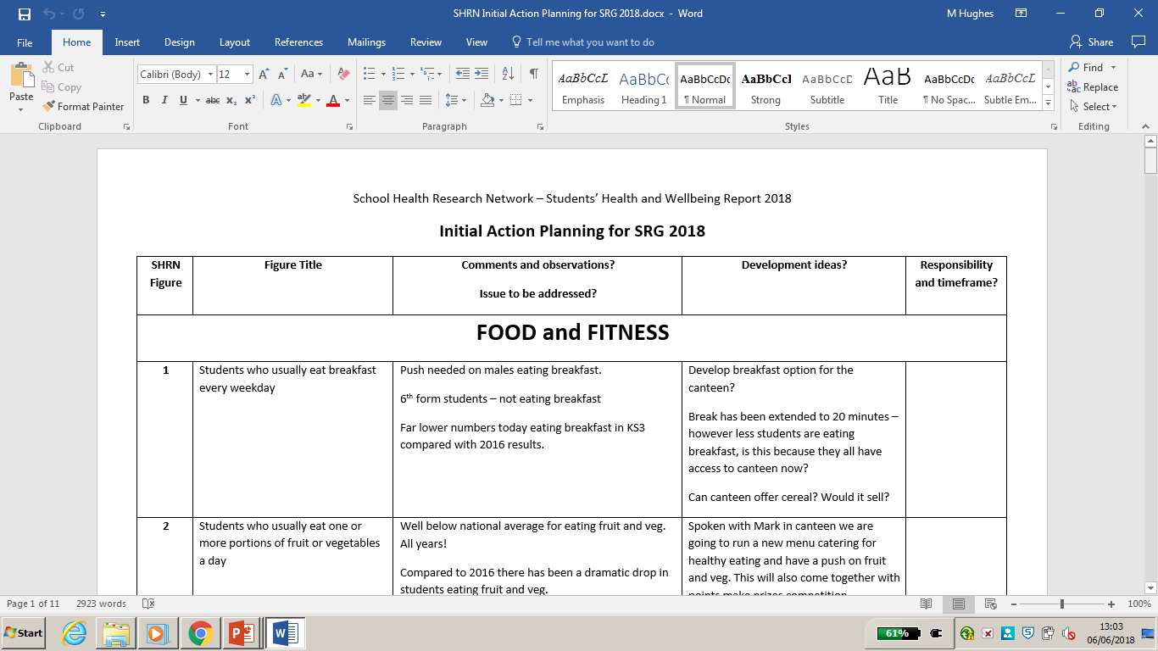
All systems go!!!
Report immediately shared with SLT.
Report analysed by myself and simplified using revised action plan template to make reading it easier.
Document initially shared with SLT and PSE Coordinator.

Slide 5
Successes and Concerns
Improved sexting results.
Improvement in contraception message…
Improvement around bullying questions…
Concerns over healthy eating and fitness.
Concerns continue in relation to substance use and misuse (county lines is growing concern with North Wales Police).
Concerns around wellbeing and emotional health
(increasingly a national issue).

Slide 6
Where next?
HoY received copy of both 2016 and 2018 reports but importantly draft of action plan. Discussed in year team meeting and feedback given to myself.
Student council will undertake a review of SHRN report and complete their own action plan in summer term.
Final action plan will be drawn together based upon all feedback.
Action plan and any other documentation will then go to SLT and Governors for final approval – Health and Wellbeing will become part of Whole School Development Plan.
Action plan will then be fed into Flintshire County Action Plan completed by Claire Sinnott.
During 2018-19 action plan will be monitored and reviewed termly.
Keenly await the data from our 2019/20 SHRN survey…

Slide 7
Professional Development and SHRN
Being part of SHRN has given me a number of extra opportunities from annual events, webinars and further healthy school initiatives.
Also through the actions introduced in school, I have been able to receive funding to complete my ILM Level 5 Senior Leadership and Management Qualification…which is focusing on Food and Fitness!

