Slide 1
The School Health Research Network: embedding a data and partnership infrastructure for health improvement planning and evaluation at multiple system levels

Slide 2
Why did we want to set up a network?
Schools are key settings for health improvement but the evidence base remains weak – and where there is evidence it’s often not fully known about or used by schools
Doing new health improvement research is challenging in UK secondary schools – time, competing demands
Lack of routinely-collected, high-quality data for health improvement planning at various levels (school, LA, national)
Examples of school networks in other countries (e.g. SHAPES, Canada) & other successful health science networks (e.g. CRN
Notes:
Recap quickly on the Network’s aims.
Focus on #1 and then Graham on #2 later.
#3 will come through in Joan and Julie’s items.

Slide 3
MRC Partnership Grant: School Health Research Network Scoping & Feasibility Study 2012
Policy & practice partners
UK & international academic partners
Notes:
Four policy and practice partners along with an academic team with experience from Canada and Australia
Thanks to the support of the MRC and these partners…
KEY LESSON 1 – partnership to set up to build reciprocal benefits

Slide 4
The School Health Research Network (SHRN) was launched in Wales in 2013 to:
Develop an infrastructure to provide timely and robust health and wellbeing data for national, regional and local stakeholders
Co-produce high quality school-based health improvement research for Wales and beyond
Build capacity for evidence-informed practice in the school health community and facilitate the translation of research evidence into practice
Increase the quality, quantity and relevance of school-based health improvement research and reduce research burden on schools
Notes:
Got it, not all of it, but first 18 months, 400k – response was very positive and enphaised theinnovation, go have a go in Wales, we didn’t longer term funding to work with partners. Right decision. Innovation. Rapidly finding out what works, what doesn’t, etc.
18 months funding for a scoping and feasibility study.

Slide 5
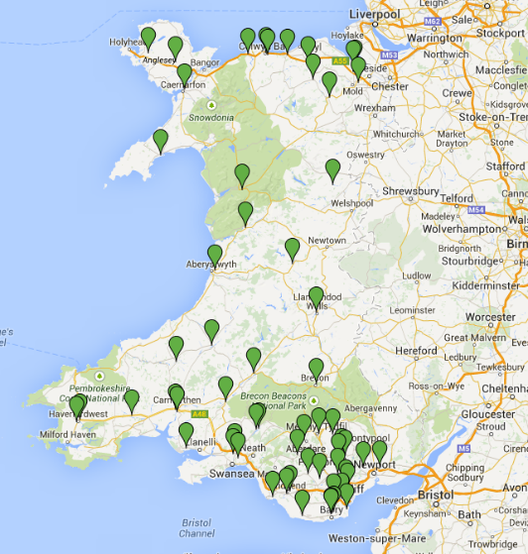
MRC scoping and feasibility study
Recruitment of 61 (of 82) HBSC schools
20/22 local authorities represented, FSM 3-45%, 12 Welsh medium
Individualised health report for all schools
Launch event (29 schools)
Piloted e-survey & data linkage methods prior to scale up (n=8)
Notes:
Recruitment undertaken by MORI. No queries came through to us. Most schools not approached.
Recruitment wave 1
KEY MESSAGE 2: HBSC – resources

Slide 6
Bi annual School Health Research Network Surveys
Notes:
Core processes is the surveys used to generate data for aim #1.
E-survey for students in autumn 2015 and SEQ covering health policies and practices for staff in spring term.
Schools managed the student survey themselves. One managed to get over 1200 students through.

Slide 7
Resources funded 2014 to 2017
Strategic Advisory Board – includes WG Education and Health, PHW, Estyn, CRUK, DECIPHer, WISERD,
Network manager (Joan Roberts) – support recruitment and engagement with schools
Network researcher (Gillian Hewitt) – manage student and school surveys and new Research Development Groups (RDGs)
Network co-ordinator (Cheryl Briscombe) – manage adoption process, network events (Webinars, newsletter)
WG and PHW investment in data infrastructure
Integration with Welsh Network of Healthy School Schemes
Notes:
Recap quickly on the Network’s aims.
Focus on #1 and then Graham on #2 later.
#3 will come through in Joan and Julie’s items.

Slide 8
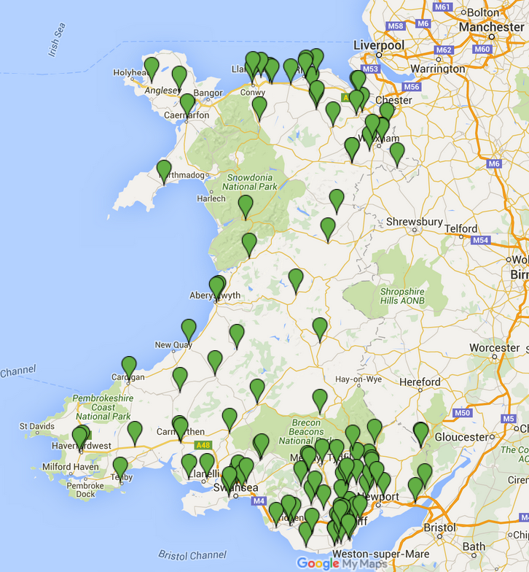
Network Scalability in 2015/16
115 (53%) Member Schools
46 new members in 2015/16
22 local authorities; 5 with full membership
275 – 1999 students
3 – 48% FSM

Slide 9
Student data set 2105/6
32,000 11-16 year olds
Large enough for analyses of minority groups and rare behaviours
Compares well to nationally representative 2013/14 HBSC data set
Gender, age and family affluence
Ethnicity
Notes:
V.Similar on gender, age and family affluence.
Ethnic minorities over-represented: sample is 88% white compared to 96% in Wales overall. This is due in part to inclusion of a few schools in Cardiff with v.high ethnic minority populations.

Slide 10
Pupil survey content
Based on the HBSC Wales survey with additional questions to reflect school, practitioner and policy-maker priorities, policy changes and emerging health behaviours
Demographics
Nutrition and PA
Smoking, alcohol and substance use
School environment
Bullying
Sexual activity and health (older YGs only)
Dating and relationship violence
Sexting, new psychoactive substances
Notes:
Teachers’ concerns at 2015 summer events – qs on sexting and nps
PHW interested in the current status of school nursing provision – SEQ
VAW bill passed in April 2015 – student and SEQ questions
Policy relevant and research interests - ecigs

Slide 11
School survey content
Physical and mental health in school curriculum
School health policies
Involvement of students in developing health improvement policies
Involvement of parents in health improvement
Partnerships
Organisational commitment to health
Overall embeddedness of health in the school health curriculum
Notes:
Teachers’ concerns at 2015 summer events – qs on sexting and nps
PHW interested in the current status of school nursing provision – SEQ
VAW bill passed in April 2015 – student and SEQ questions
Policy relevant and research interests - ecigs

Slide 12
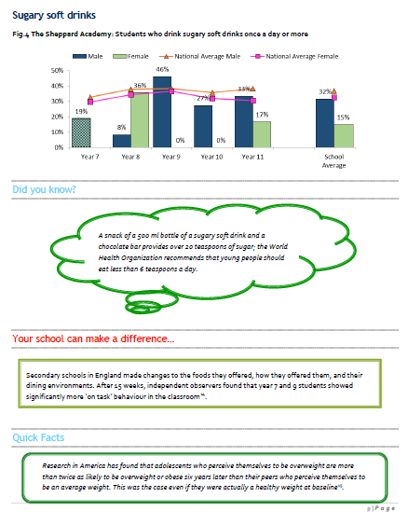
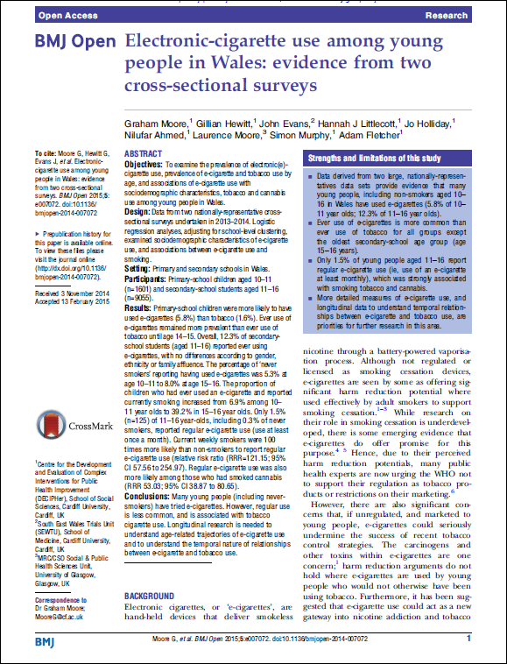
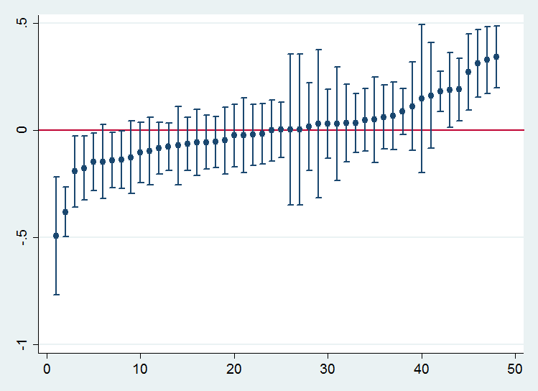
Pupil Survey
School Survey
School and Regional level data to inform local action /evaluation and generate research ideas
Population level data on trends, health need planning and international comparison
Practice level data to support WNHSS
Infrastructure to support new studies ( recruitment,
sampling, baseline/context data)
Infrastructure to support natural experiments (Future Generations, Violence and Women, Curriculum Review)

Slide 13
2017 – Full Diffusion
Aim of 100% diffusion in secondary schools
HBSC embedded - reduced costs and value added capacity development (other surveys?)
Development of measures for policy and practice – subjective well being, curriculum review etc.
Sub study unique identifiers for cohort and linkage
Engagement events to develop SHRN to meet partners needs
Future sustainability?
Notes:
Teachers’ concerns at 2015 summer events – qs on sexting and nps
PHW interested in the current status of school nursing provision – SEQ
VAW bill passed in April 2015 – student and SEQ questions
Policy relevant and research interests - ecigs

