Slide 1
Brynteg School Bridgend
Kate Perna
Learning Director for Pupil Participation Head of Geography
ka.perna@bryntegcs.bridgend.sch.uk

Slide 2
Brynteg School
Mixed 11-18 Comprehensive
Approx 1500 on roll including 400 in 6th Form
Green 1A School
68% L2 inc. (2016)
Most recent Estyn inspection GOOD (December 2016) in all 5 inspection areas under new framework
Approx 14% FSM
Draw pupils from a wide variety of socio-economic backgrounds and ethnically the school is predominantly white, British.

Slide 3
Our journey with SHRN to date…
Joined the network in 2013
2013/14 survey
126 pupils completed survey
(sample of 1 form class from years 7 -1 1)
2015/16 survey
1244 pupils completed survey

Slide 4
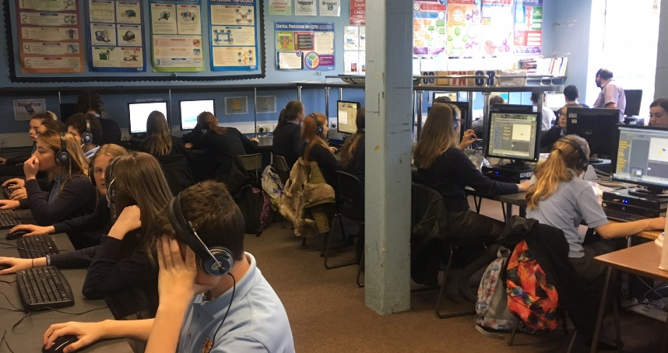
How did we achieve this?
Aim: All pupils to complete questionnaire over a 2 week period
KS3 pupils – all pupils completed the questionnaire during an ICT lesson at the end of the Autumn Term.
KS4 pupils – timetable produced for Form Tutors to register in computer rooms throughout a 2 week cycle. Pupils had 20-25 minutes to complete
KS5 pupils – 30 minutes of an Enrichment lesson allocated over 2 week period.

Slide 5
How did we achieve this?
Links on the school Moodle page
FTs/ICT teachers given the brief/information to share with pupils beforehand – opt in/opt out
Reminders emailed to staff the day before as a reminder
Notices given in morning briefings.

Slide 7
Who have the results been shared with?
ALL STAFF
Senior Leadership Team
Progress Leaders & Assistant Progress Leaders
Subject Leaders – PSE in particular
Parents
Governors
Pupils

Slide 8
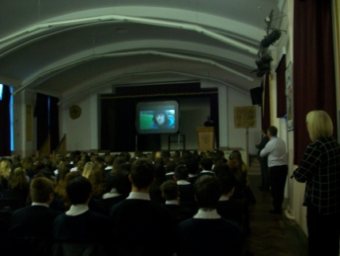
How have the results been used?
PSE curriculum
Further interrogation of the data from SHRN in relation to psychoactive substances
Met with school Police Liaison Officer and PSE Subject Leader
Discussed issues in relation to this topic around the Bridgend area
Delivered a talk to the whole of Year 10 on this topic – students off timetable to stress importance of this.

Slide 9
How have the results been used?
PSE curriculum
Dove – Body Image workshops
Year 9 were identified as having the poorest scores in relation to body image.
Targeted Year 8 classes to help to address this in future years.
Staff also received training on delivering future workshops.
https://www.dove.com/uk/dove-self-esteem-project/school-workshops-on-body-image-confident-me.html

Slide 10
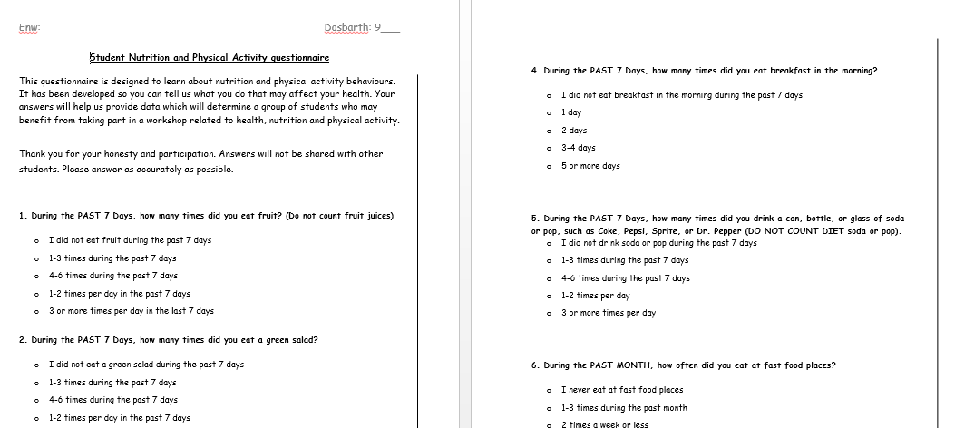
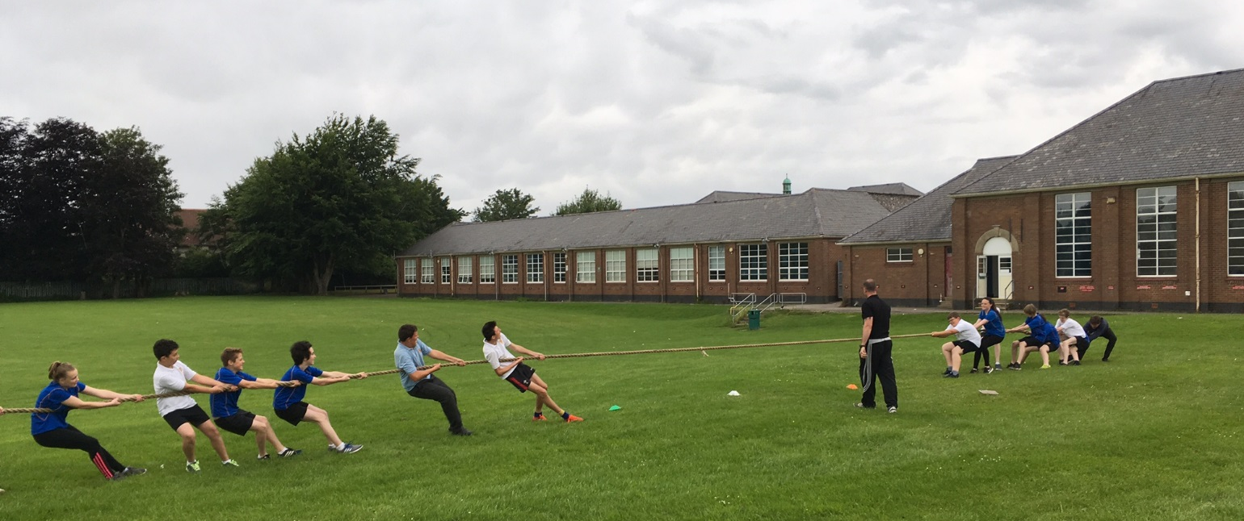
How have the results been used?
One off workshops
Results showed that healthy eating and lack of engagement in physical activity was a concern for some in Year 9.
Devised a more focused questionnaire based upon these topics to identify specific patterns within the year group.
30 students were selected that scored lowest in their engagement in physical activity and attitudes to Healthy Eating and they were invited to attend a one off fun and engaging workshop run in school time by Forces Fitness.

Slide 11
How have the results been used?
Mail shots to parents
Used some of the results from the questionnaire and created information sheets included in the ‘Brynteg News’ (online school bulletin)
Included information from government guidelines and had support from Healthy Schools Practitioner to provide accurate information to parents.

Slide 12
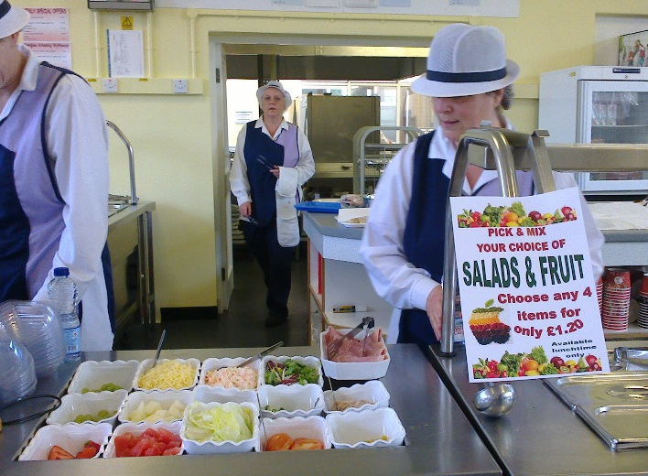
How have the results been used?
In conjunction with School Council work
Through pupil voice, it was identified that students wanted to review the canteen provision, especially the variety of healthy foods available.
The school council met to discuss how to tackle this and making use of the well being data in relation to this topic a highly successful review and revamp was carried out of the foods available.

Slide 13
Hopes for 2017/18 survey
Strategic use of the next Health and Well being report to inform planning for the new ‘Qualified for Life’ curriculum in 2018. (Purpose 4 – All our children and young people will be healthy and confident individuals)
Use the report to measure the impact of actions taken in relation to student well being.
Greater use of the report by a wider range of staff
Greater flexibility in manipulation of data for school use
Development of school-to-school links to share ideas and collaborate on projects.

Slide 14
Diolch yn fawr! Any questions? ka.perna@bryntegcs.bridgend.sch.uk

