Slide 1
Ysgol Bae Baglan
School Health Research Network
Miss Annette Stead
Head of PSE / Healthy Schools

Slide 2
Ysgol Bae Baglan
Port Talbot
A 3-16 provision opened September 2016

Slide 3
SHRN - 2017
Signed up end of first year of the school opening
Knowledge Ease Data
Administered by PSE/ Welsh departments
Technology Consistency ALN Relationships Consent

Slide 4
Results – Spring 2018
Shared immediately with SLT/ Wellbeing Team/ Heads of Department
Used for school developing planning by Wellbeing Team
Used by PSE Department/ Healthy Schools
Presented to Governors
Focus areas shared with all staff
Relevant elements referred to with parents and pupils

Slide 5
Used in Wellbeing Team’s development planning
Year 7 Bullying
Negatives
Positives
Actions

Slide 6
Used by PSE / Healthy Schools
PSE Programme of Study
Impact Social Media
Body Image
SRE

Slide 7
Whole School Project
Healthy Schools: Food and Fitness
Presented to Governors
Focus areas shared with all staff
Relevant elements referred to with parents and pupils
Inspection November 2018
Evaluate and review SHRN 2019-20
County level

Slide 8

Brynteg School
Bridgend
Kate Perna
Learning Director for Pupil Participation
Head of Geography
ka.perna@bryntegcs.bridgend.sch.uk

Slide 9
Aims
Brief introduction to Brynteg
Our SHRN journey
Use of data
School research involvement

Slide 10
Brynteg School
Mixed 11-18 Comprehensive School
Urban area with a population of approximately 50,000.
Approximately 1500 on roll including 400 in 6th Form (largest in the county)
60% L2 including English & Maths, grade C and above (2018)
Approx 13% FSM
Draw pupils from a wide variety of socio-economic backgrounds and ethnically the school is predominantly white, British.

Slide 11
Our journey with SHRN to date…
Joined the network in 2013
2013/14 = 126 pupils (sample)
2015/16 survey = 1244 pupils
2017/18 survey = 1161 pupils

Slide 12
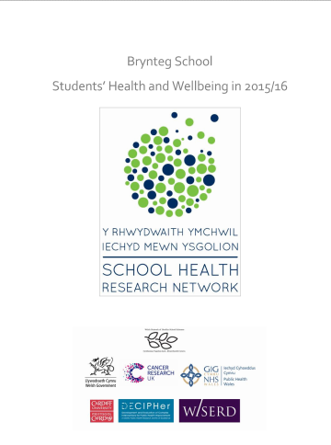
Who have the results been shared with?
ALL STAFF
Senior Leadership Team
Progress Leaders & Assistant Progress Leaders
Subject Leaders – PSE in particular
PCSO & other support staff
Parents
Governors
Pupils
SIG (School Improvement Group)

Slide 13
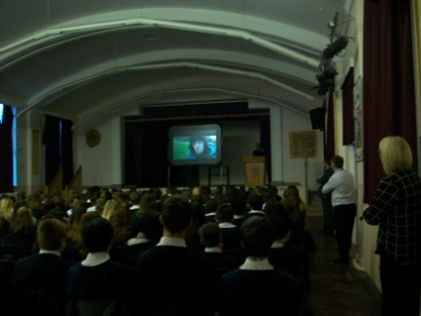
How have the results been used? STAFF
PSE curriculum
Further interrogation of the data from SHRN in relation to New Psychoactive Substances
Met with school Police Liaison Officer and PSE Subject Leader
Discussed issues in relation to this topic around the Bridgend area to feed into the lessons.
Delivered a talk to Year 10 on this topic – students off timetable to stress importance of this and introduced distinct workshops in Year 9 on ‘Wellbeing Day’

Slide 14
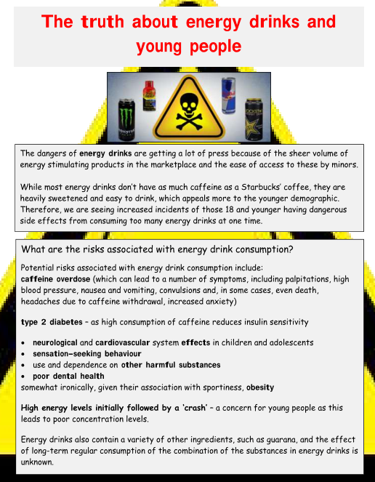
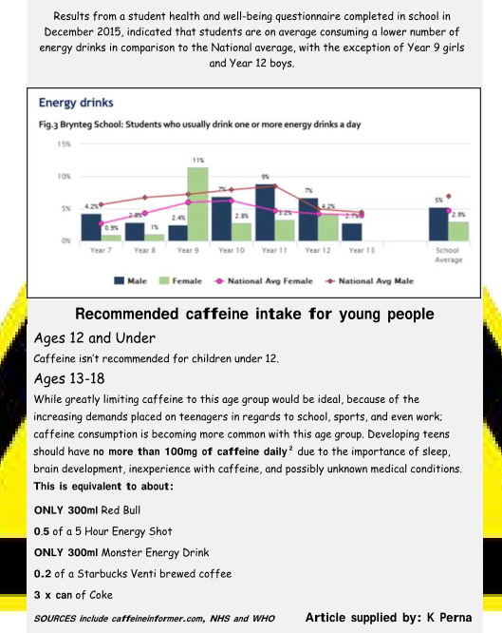
How have the results been used? PARENTS
Mail shots to parents
Used some of the results from the questionnaire and created information sheets included in the ‘Brynteg News’ (online school bulletin)
Included information from government guidelines and had support from Healthy Schools Practitioner to provide accurate and up to date information to parents.
Liaised with ‘Healthy Schools’ co-ordinator to obtain most up to date guidelines.

Slide 15

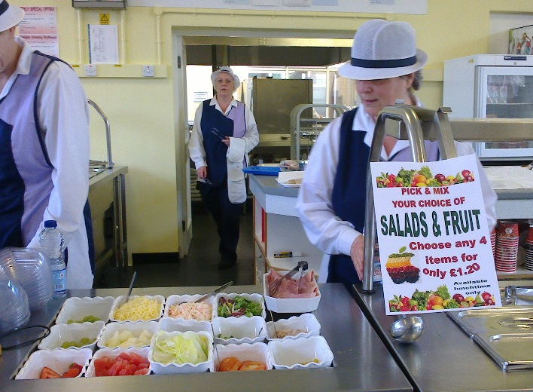
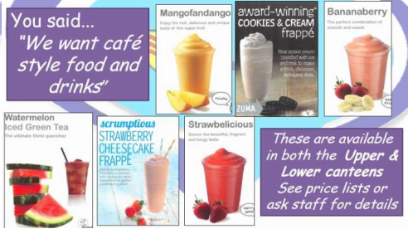
How have the results been used? PUPILS
In conjunction with School Council work
Through pupil voice, it was identified that students wanted to review the canteen provision, especially the variety of healthy foods available.
The school council met to discuss how to tackle this and making use of the well being data in relation to this topic a highly successful review and revamp was carried out of the foods available.
One canteen has been renovated and opened as a café as our older pupils wanted access to food throughout the morning – we had identified that many were skipping breakfast from the survey.

Slide 16
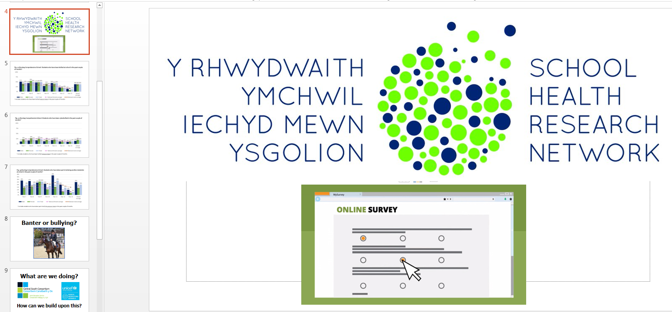
How have the results been used? PUPILS
Shared with pupils in assemblies.
Theme 0f the week – ‘Responsible Behaviour’
Linked with ‘Bullying’ section and launched
Anti-bullying campaign ahead of anti-bullying week.
Increase in discussion about the topic following the assembly and in numbers supporting the campaign.

Slide 17


How have the results been used? SIG
School Improvement Group (Regional Improvement Collaborative)
Shared summaries from the report across the group and prioritised 3 common areas to develop PSE resources/assemblies to share with the group.
Informal discussions and sharing of ideas and contacts and opportunities.

Slide 18

Research opportunities and University Links
Opportunity to take part in world leading research
Participate in specific studies that may help to address school based issues.
Provide a link between the school and Higher Education to support students now and develop their understanding of what happens at University.
Offer professional advice about the development and practicalities of new school based studies.
Access to literature to support Professional Development.
Contemporary methods of sharing feedback through Webinars and reports.

Slide 19
Diolch yn fawr!
Thank you! ka.perna@bryntegcs.bridgend.sch.uk

Slide 20

Ysgol Penrhyn Dewi VA
3 to 16
A Transformation Model through Health and Wellbeing
David Haynes, Headteacher @daviddewisant
Rachael Thomas, Head of Secondary Phase @Rachael45086397
Ysgol Penrhyn Dewi VA @Penrhyndewi
12th January 2019

Slide 21
September 2018 saw the Opening of Ysgol Penrhyn Dewi, the first Church in Wales 3 to 16 School in the World!

Slide 22
Where are we now
Outcomes

Slide 23

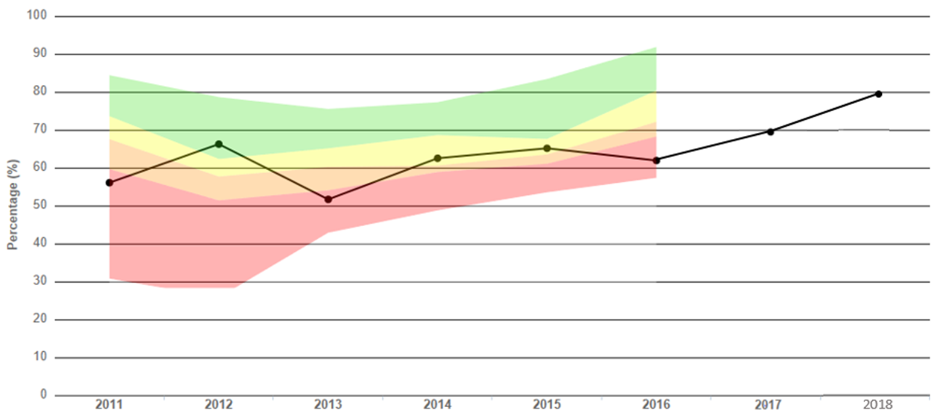
% Pupils achieving the L2 inclusive threshold (Q1, Residual +10.5%)

Slide 24
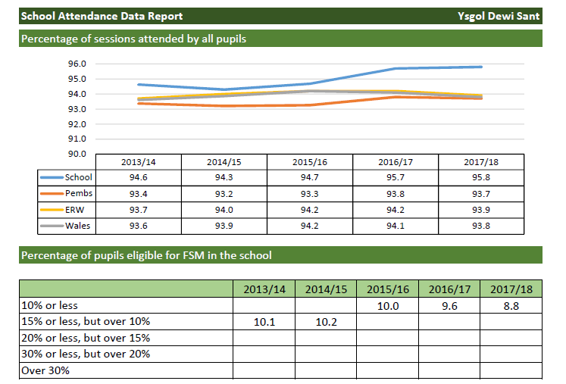
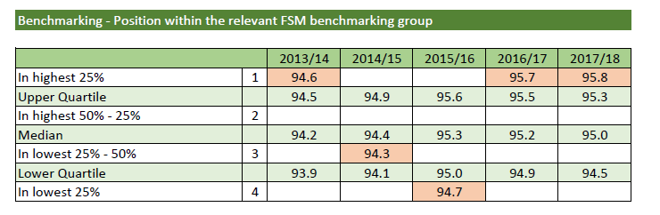
Attendance at 95.8% (Q1, R +1%)

Slide 25

2013 issues
Children were no longer the focus of the school – hadn’t been for some time
Four unions threatening industrial action
Headteacher on long term sickness
Headteachers PA on long term sickness
One member of the SLT in school – Deputy Head with just over a years experience
Subsequent HR investigation into the wellbeing of staff – findings linked to intimidation and bullying on a number of sides
LA Education department in Estyn Special Measures
No recognisable staffing structure with clear lines of support and challenge
A performance management system which was a paper exercise
Threat of closure – public meeting in the City Hall

Slide 26

Welsh Government warning letter issued
Estyn inspection – judgement ‘In Need of Significant Improvement’
Nine recommendations set by Estyn who would return in 12 months
Leadership and Teaching deemed ‘Unsatisfactory’
Silos of good practice in the classroom and some excellent leaders
Although weaknesses in over half the lessons observed there were excellent teachers and excellent lessons going on
A willingness and desire by the Acting Head and Acting Deputy to realise the potential of the staff and pupil
WELLBEING OF PUPILS JUDGED ‘GOOD’

Slide 27
“The era of procrastination, of half-measures, of soothing and baffling expedients, of delays is coming to a close. In its place, we are entering a period of consequences.”

Slide 28
What have we done with Pupils’ Health and Wellbeing?
Create a positive climate and culture – Health and Wellbeing including mindfulness underpinning the entire school ethos
Use of the data rich School Health Research Network Report to inform planning
Membership of the Welsh Network of Healthy Schools Scheme
Re-focus on the whole school core values of respect, honesty and truth with pupil wellbeing at the centre of everything we do
An ethos of teacher wellbeing – Oxford Psychometrics
Leaders having an open mind in identifying and sharing
best practice – Outward looking leadership
Current attendance at lunch time & after school sports activities is 84.5%
Mindfulness courses (.b, Paws b and MindUP) for our children and teachers
Clear focus on the present – uncertain future with loss of sixth form and relocation of school to Haverfordwest (16 miles) during re-modelling of the school

Slide 29
What have we done with Pupils’ Health and Wellbeing?
Use of data collated from the SHRN report to initiates the following:
Whole school PSE Drop Down days (Linked to feedback on the four health topics)
Tailored year/target group intervention days: Healthy relationships, social media
Mobile Phone policy
School Well-being committee, members include pupils, staff, governors, parents.
Peace Mala Diversity Project
Community sports, fun activity days
Healthy School rewards visits using the local beaches and providers at no cost
Exam breakfasts/water – sponsored by Princes Gate
School Police liaison/Choices/Mental health Advocacy etc delivery of assemblies/School Sennedd

Slide 30
Now this is not the end. It is not even the beginning of the end. But it is, perhaps, the end of the beginning.

Slide 31


Follow us on ww.facebook.com/ysgolpenrhyndewi
Follow us on @penrhyndewi
@davidewisant @Rachael45086397
www.ysgolpenrhyndewi.cymru
www.ysgolpenrhyndewi.wales

Slide 32


The School Health Research Network – What have we been doing in the Vale of Glamorgan?
Christine Farr – Vale of Glamorgan Healthy Schools Coordinator – Cardiff and Vale Public Health Team
Danielle Diver – PSE Co-ordinator – Pencoedtre High School
8th July 2019

Slide 33
Participation in SHRN – Vale of Glamorgan
100% schools (8/8) participating in the latest survey
Student participation within each school from 68-81%
All schools have really valued the data and been using it widely.

Slide 34
Partnership Working
Vale Healthy Schools working with colleagues in VOG Learning and Skills
SHRN integral part of ‘Wellbeing in Education’ approach including informing development of a Policy
Joan presented on SHRN to our ‘Wellbeing in Education’ forum group
Youth Consultation Event in March this year.

Slide 35
Action planning
Vale Healthy Schools offered support to each school with analysing data and developing action plans.
Included identifying appropriate organisations that can support.
Schools were asked to involve pupils in this work and promote their data widely across the school community.
Schools were pleased to have data to monitor improvement and evaluate interventions and changes made.
Notes:
Danielle from will talk about her school’s SHRN journey before we both talk about a new approach tried in the Vale this year.

Slide 36
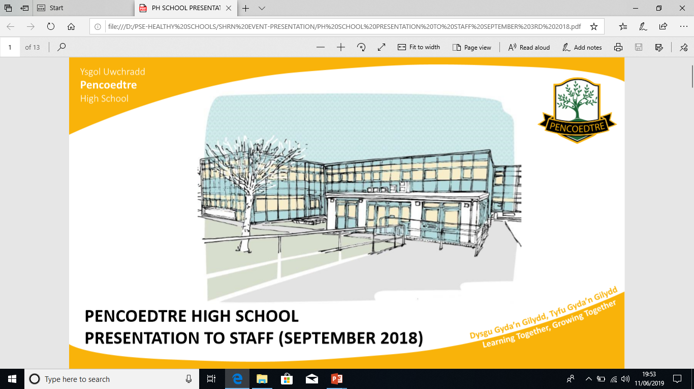

Pencoedtre High School is an 11-18 co-educational comprehensive school with a joint Sixth Form, (with Whitmore High School) for up to 1200 pupils.
Our catchment area is the eastern half of Barry. Our intake covers a wide social and ability spectrum.
The school has 32% efsm overall but this will rise in future years. Current Year 7 are 36% efsm.

Slide 37
Actions from SHRN
2014
PSE delivered as a carousal once a fortnight
Work with outside agencies
Whole school approach
Updated and shared resources
Pupil Voice opportunities

Slide 38
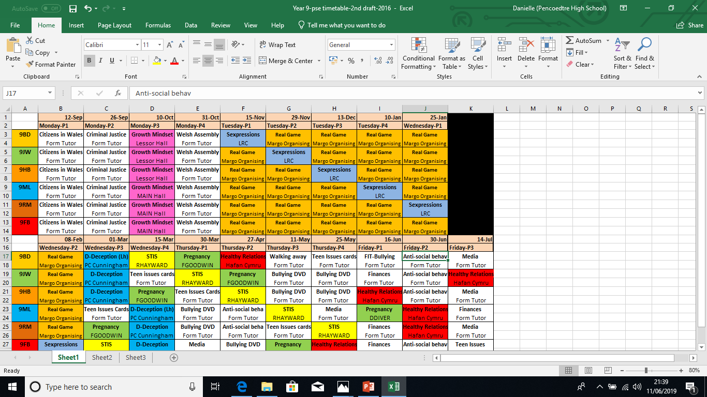
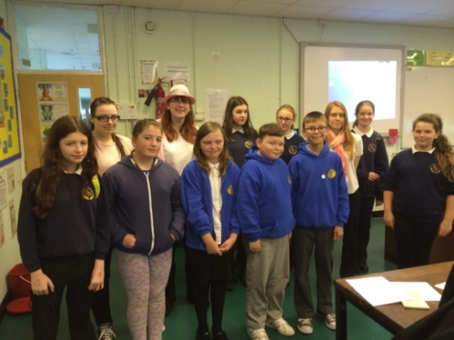
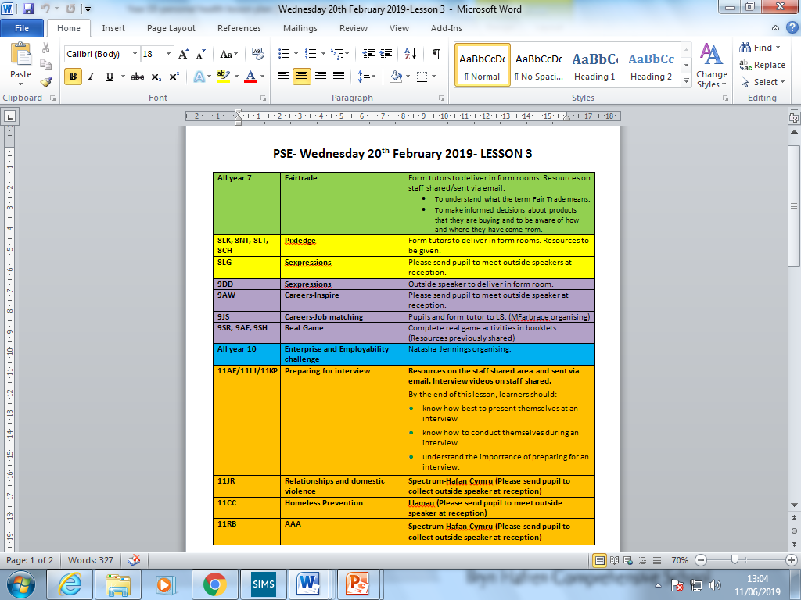
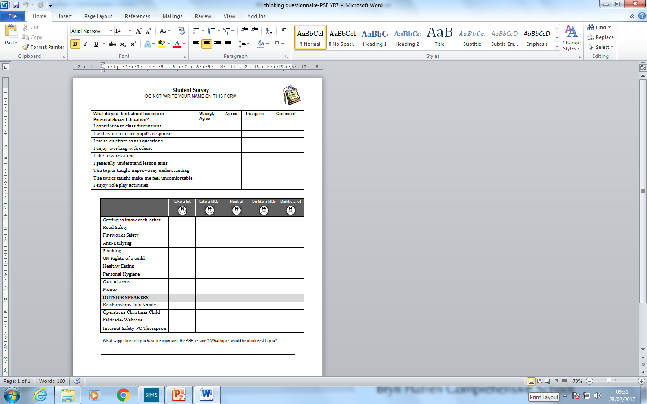
Benefits
Opportunities for outside speakers
Use of halls
ICT Suites/chrome books available for surveys
Improved attendance
Relationships built with tutors
Pupil voice activities
Working with parents and feeder schools
Science teachers to teach some SRE lessons

Slide 39
More SRE lessons
Finance lessons
Interview techniques
CV writing
Mortgage advice
Role play activities
Games
Films
Outside speakers
Needs to be more relevant and must reflect the issues facing young people today.
LGBT+ lessons in PSE
Pupil voice response

Slide 40
Actions from SHRN Results
2016
Sexting workshops
Internet safety lessons
SRE lessons to be taught in year 9
PLC/Twilight
Staff encouraged to sell other items during charity breaks.
Growth mindset
DEAR lessons
Use data to work towards phase 6
Compare results with 2018
Use RAG to plan actions
Selfie programme

Slide 41
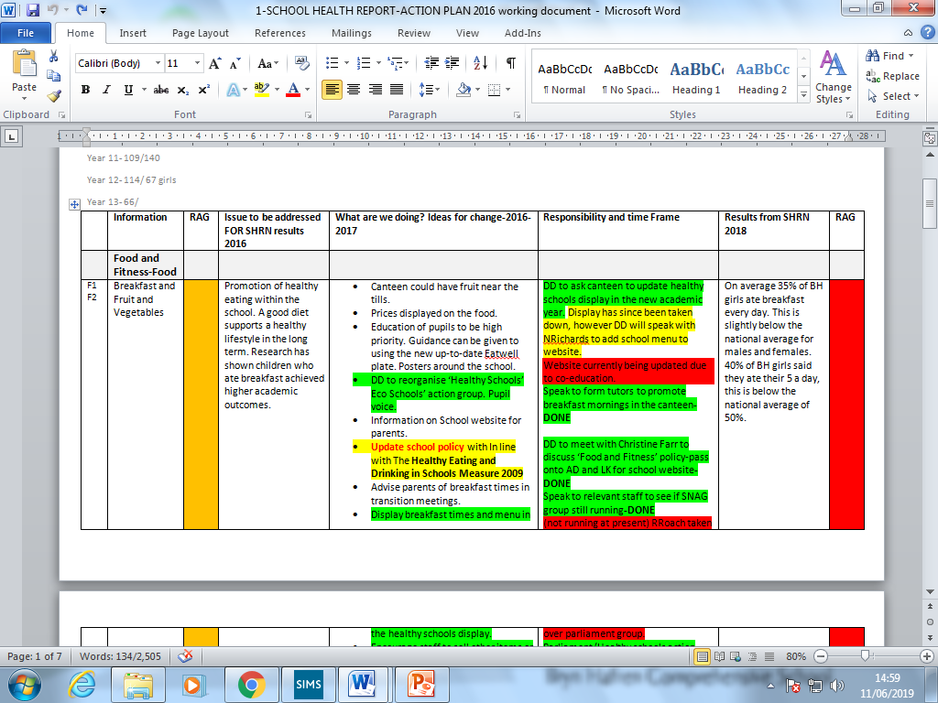
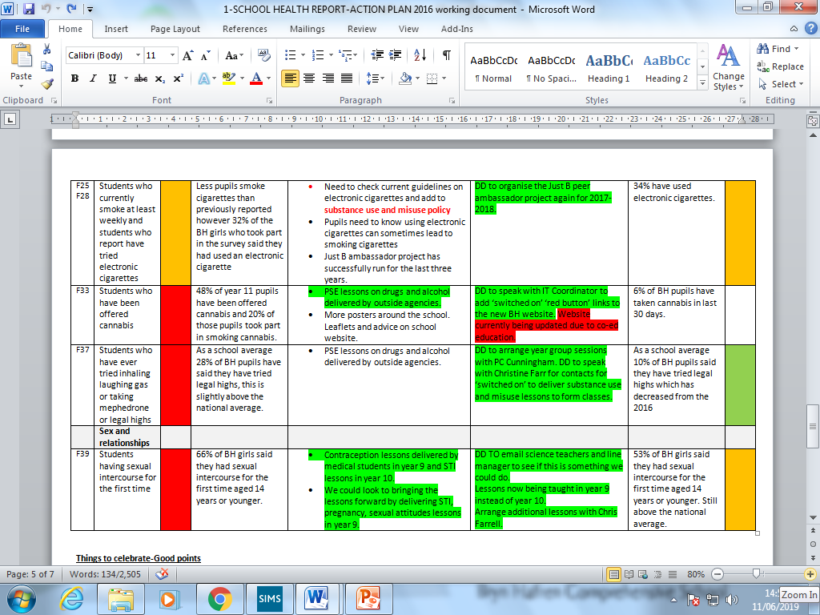

Slide 42
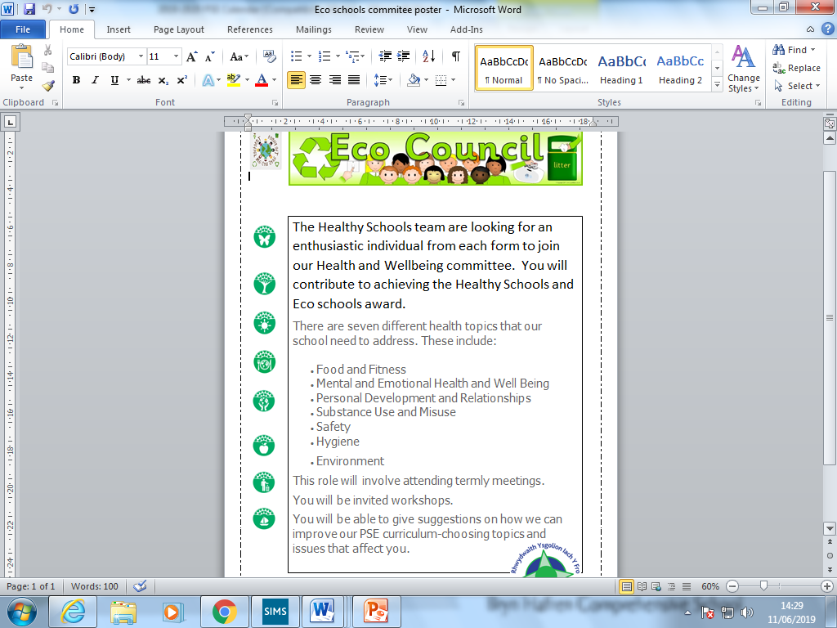
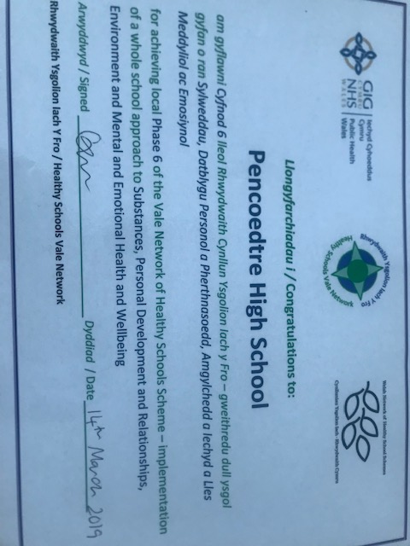
Achieving phase 6 award
Setting up our health and well-being committee

Slide 43
Promote healthy eating
Breakfast club
Nurture room
Well-being Hub
Confidence building workshops in PSE
Energy drinks banned in PHS
Lessons promoting positive health
Pupil voice opportunities
Parent questionnaires at parents evening
Well-being hub putting Interventions for ACEs and young carers
Transition events and MAT clubs to build relationships with primary school pupils.
Use data for individual projects
Health and Social GCSE / A Level work
Actions from SHRN Results
2018

Slide 44
What next?
Ideas from SHRN event/Pupil voice
Wellbeing across the curricular.
Health and wellbeing section in newsletter
More use of twitter to promote clubs in the area.
More lessons and greater focus on mental health, coping strategies.
Staff well-being is a focus (PLC set up)
(New challenges due to having boys)
More of a focus on good behaviour rather than bad behaviour
Peer mentoring- Year 12/13 pupils to help deliver PSE lessons for their community challenge.
Improving teacher-pupil relationships by mentoring.
Resilience work.
Pressure and anxiety guidance.
Look at family of schools SHRN data.
Look at 2020 data since becoming a coeducation school.
Look at patterns in different year groups.

Slide 45
Youth Consultation Event – 21st March 2019 – Barry Memo
The aim of the youth consultation event was to dig deeper into the Local Authority level SHRN findings through a topic focus, encourage students and staff to become familiar with their own school reports and develop realistic action plans.
Information gained during the day from students, school staff, and stakeholders would be used to inform a Local Authority level response.
All Vale secondary schools who are part of the School Health Research Network were invited to attend. 5 out of 8 Vale secondary schools accepted the offer, with the remaining 3 having other clashing commitments on the day of the event. 49 pupils and 5 accompanying staff attended.
A range of stakeholders representing each of the main SHRN topic areas were invited to support the event by developing and leading consultation workshops.
Notes:
I removed the one with the timetable on…I think this covers the important information…

Slide 46
Youth Consultation Event – 21st March 2019 – Barry Memo
Appreciated being given a voice!
Some of the things we found out:
The students increased their
knowledge!
Would like more information on healthy relationships.
No time to eat breakfast.
Not enough fruit available at home or school.
Pressure to chose subjects to early and pressure from everyone on results.
Not able to relax – stress / sleep problems. Teachers are stressed too!
Pupils were clear in their preference for outside agencies to deliver substance misuse education.

Slide 47
Youth Consultation Event – 21st March 2019 – Barry Memo
At the end of the day, students were asked to come up with 5 main actions to take back to schools; a few examples:
Discuss mental health issues with peers.
More visiting speakers on healthy relationships
Later bus home so pupils can take part in after school activities
Help those misusing drugs and alcohol – don’t punish them.
Space and time to read quietly and relax during the day

Slide 48
What next?
Prepare for next round of surveying in the Autumn
Assess success of action planning process.
At a Local Authority / Stakeholder level – continue to develop interventions – eg CAMHS are already offering extra sessions on ‘sleep’ and the Youth Wellbeing Service on ‘Exam Pressure’. Healthy Schools and Vale Council Health and Safety Team continue to work on staff health and wellbeing.

Slide 49
Thanks / Diolch!
Christine Farr – Vale of Glamorgan Healthy Schools Scheme, Cardiff and Vale Public Health Team
Christine.farr@wales.nhs.uk
02921 832110
Twitter - @schoolhealthvog
@ysgolioniachfro

