Slide 1
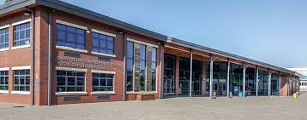
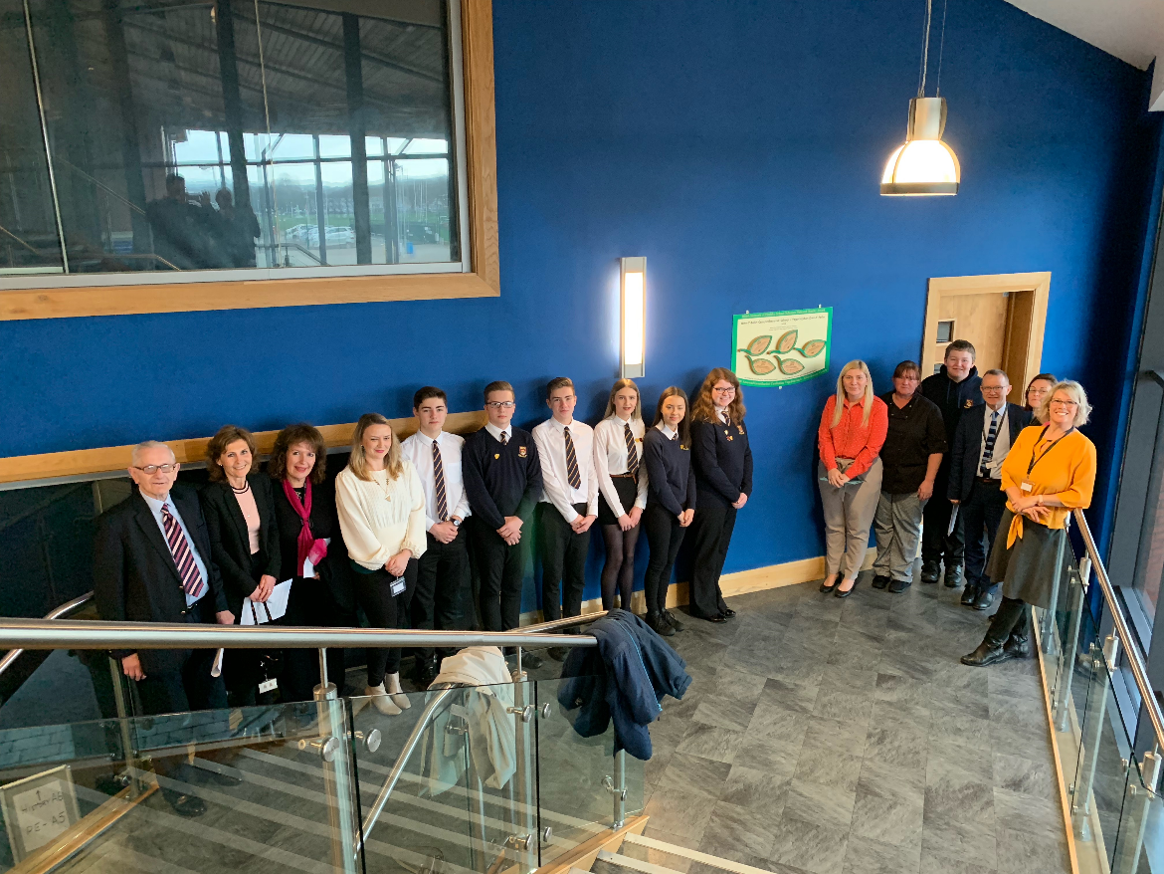
Dwr Y Felin School
NQA Journey and the supporting role of SHRN data

Slide 2
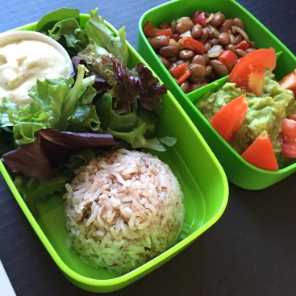
NQA JOURNEY
Ethos and culture has changed due to the current high profile of health and wellbeing
Head of PSE and Citizenship at Dwr Y Felin. 11-16 school in centre of Neath.
Took over as Healthy Schools Coordinator in 2010 where we were on phase 4, every two years we successfully achieved up to phase six and embarked on the National Award last year.
Seven topics all relating to health and wellbeing.
Improvement seen as a result of ESTYN including wellbeing in the Inspection Area 2 of the new framework, school had to self evaluate what we were doing and NQA supported a lot of what we did
Commended for our development of pupil voice and the different student bodies that sit on school parliament.
Compliant menus
Healthy fundraising
Healthy lunchbox
Rewards
Role modelling
Parental involvement
Wellbeing ambassadors and other student bodies
Mindfulness in the curriculum
A happy, healthy child learns

Slide 3
How the SHRN questionnaire helped
First completed in 2017
Easy process – we have excellent IT facilities at school and as we teach PSE as a timetabled lesson once a week, we found little difficulty in completing the questionnaire
Importantly it gave us valuable data, highlighting issues within each year group for us to target during pastoral time, assemblies, parents evening and PSE lesson.
Shared with SLT, staff, governors, parents and pupils.
Allows us to be more flexible with the PSE curriculum and target issues that effect pupils, e.g cannabis in year 10, external agency support
All the above contributed to us achieving the NQA and we were commended by the assessor in certain areas as a result of how we responded to the SHRN data.
Interested to compare data from this year’s survey to see if we are able to see changes as a result of the intervention put in place.
SHRN (School Health Research Network) data is analysed by the Senior Staff Team and targeted responses are made to make maximum impact. For example, changes are made to PSE and assemblies in response to awareness of highlighted issues.

Slide 4
“There can be no doubt that Dwr Y Felin Comprehensive School is a health promoting school and that it is completely deserving of its National Quality Award. During the visit it quickly became very apparent that the concept of the healthy school and the protection and promotion of the physical, mental and spiritual wellbeing of everyone connected to the school are fully and completely embedded in the life and culture of the school.”
“When wellbeing is at the heart, achievement follows”
“The importance and impact of pupil voice in all aspects of school life, the curriculum and the school food provision. The culture of the school is one of enabling participation.”
‘This is a very pupil centred school’
‘Teachers listen to us and act on our ideas’
‘This is a very open and supportive school’
‘The school is brilliant and approachable’

Slide 5
Since the NQA we have been involved in 2 further research projects:
Working with Decipher to see how we can improve the survey. Suggestions are that we look at some areas in years 5 and 6?
Secondly we have been involved in research into online harming behaviours with Bedfordshire University.
Using the results from the localised survey we have met as PSE/Healthy Schools Coordinators across NPT to evaluate whether the issues arising at our own individual schools are replicated across the authority. We are hopeful that this information would be helpful in gaining funding will help our vulnerable pupils.
Currently as a result of both the SHRN survey and NQA we are embarking on a petition to Welsh Government to ensure that every school in Wales has wellbeing ambassadors as they were highlighted as good practice from the NQA.
Furthermore, its not just the survey that has been useful but the meetings have allowed me to network and share/steal ideas from other school which has been invaluable e.g.trauma informed training.

Slide 6
Relationships at Monmouth Comprehensive School
Reflections on our culture and ethos to learning and relationships, in order to make a difference.

Slide 7
4 years within SLT - New to role as Assistant Headteacher responsible for Wellbeing 2018-19.
Integral member of core staff that have fostered and developed curiosity around learning behaviours and wellbeing over 16yr period
20 Years within the Pastoral System – different systems; moral compass?

Slide 8
Philosophy
Holding to your shared beliefs, principles and values.
Knowing what works and seeing it through. (Resilience and Determination).
Explore, experiment and be open to ideas and views.
Model it every day and in every way – be the Sun not the Wind.

Slide 9
Culture
Fostering a culture and ethos of well-being and respect for all that allows learners to be safe, healthy and secure.
Providing an inclusive curriculum that interests and enthuses learners so that all can achieve.

Slide 10
MCS SHRN Data – impact?
Wide level of engagement – meaningful data.
An excellent example of Pupil Voice – What are young people saying about your organisation?
Explore, experiment and be open to ideas and views

Slide 11
Topics we have explored…
Questions 72-76 relate to perspectives of;
Quality of relationships
Relationship with self and perceptions of others
Support & Feedback
Positive Citizenship

Slide 12
Our School Values
Respect
Mutually respect all people in our school
Treat others how you would wish to be treated
Listen to and look out for each other
Respect buildings, property and facilities
Value others’ individuality, diversity and perspectives
Freedom with Responsibility
Use all technology with responsibility and as asked
Behave appropriately in unstructured time, especially in eating spaces and hubs
Take responsibility for your actions
Wear correct uniform with pride
Attend school regularly, be on time and know your attendance percentage
Independence
- Attend school with a positive attitude and the equipment to learn
Be independent in learning in your lessons and outside of lessons
Take pride in your learning; set your own targets and goals and be responsible for progress
Be proactive in learning, time management and workload
Build resilience and develop intrinsic motivation
Security
Talk to people about your emotions and wellbeing
Develop secure learning relationships with peers and staff
Tell someone if you feel upset or threatened
Be aware of personal safety – keep passwords safe, belongings, stay safe on social media
Success
Share success in a variety of ways
Celebrate more than just grades
Act on feedback in learning
Value the success of others
Have unwavering belief in the core principle that all can achieve

Slide 13
Include different people;
- Variety of perspectives
- Encourage responsibility & ownership
Allow Students to own the School Development Plan;
- Language they understand
- What can students do to make a difference?
Utilise relationships you have with other people;
- Create opportunities to grow relationships
SHRN Area Representative
Wellbeing Governor and/or others
Parents
External Agencies

Slide 14
To
Uncertainty
Happy
Satisfying
With
Demeaning
Chaotic
Achievement
Not progressive
Efficient
Stressful
Balanced
Helpless
Variety of learning
No self confidence
Freedom
Equal
Stuck
Appreciated
Failure fear
Structured
Depressing
Trust
Useful
Suitable Challenged
Struggle
Frustrated
Involvement
Unguided
Lack of respect
Motivation
Progressive
Fun
Demoralised
Lonely
Joint Engagement
Enthusiastic
Challenge, Expectation & Accountability
What’s the point – stay home
Annoyed
Easy
Unhappy
Spoon-feeding
Upset
Pointless
Demotivated
Disappointed
Laid-back
Frustrating
Agitated
Pointless
Awkward
Basic
Limited
Confusing
Insecure
Restricted
Waste of time
Aimless
For
Not
Boring
Exasperating
Patronising
Resentful
Angry
Boring
Disappointed
Underestimated
Downhearted
Care & Support

Slide 15
Build a sense of self-worth and being valued for all – listen and be heard.
Every opportunity to celebrate in different ways the lives of students and staff- build capacity in all.
Communicate regularly and without hesitancy the ambition, pride and passion of the school – empathy and optimism
Be consistent in language and actions – security, safety, rigour

Slide 16
Basic principles of Relational Practice
Everyone has a unique perspective and the right to have their voice heard.
Thoughts are linked to feelings and feelings to actions.
Our actions have an impact on others.
These actions are linked to our needs, or, more often than not, our unmet needs.
Young people need to be supported to take responsibility for their actions and plan the best way forward.

Slide 17
Ysgol David Hughes

Slide 18
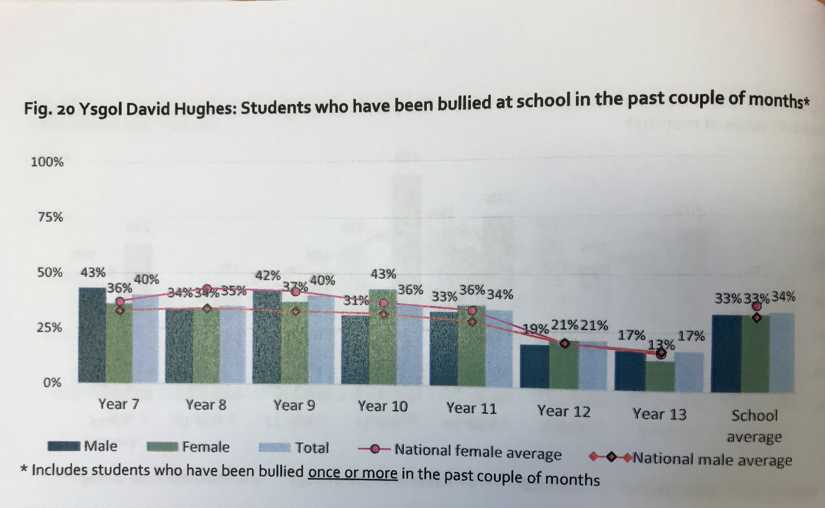
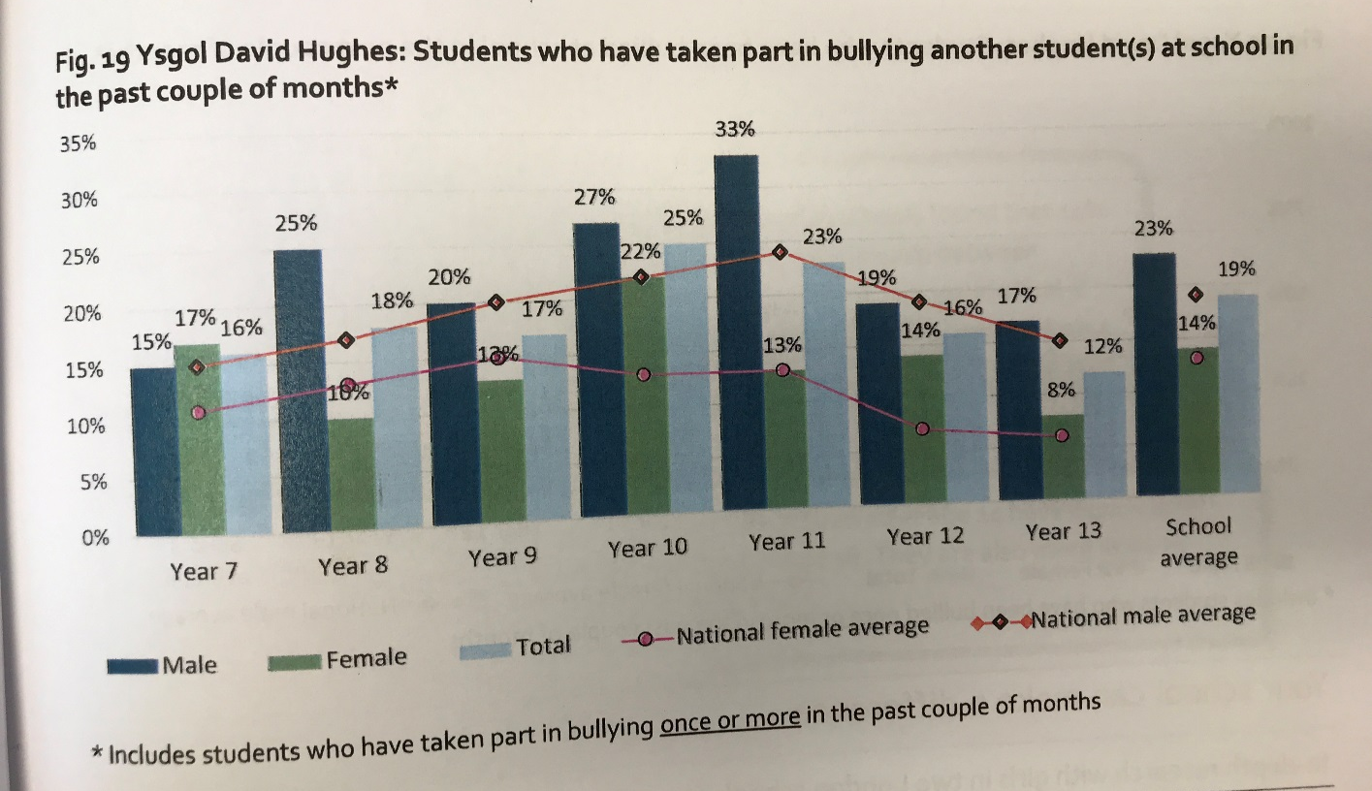
Ysgol Gyfan
Whole School

Slide 19
Cynghorau Blwyddyn a Llais y Dysgwr
Year Councils and Pupil Voice

Slide 20
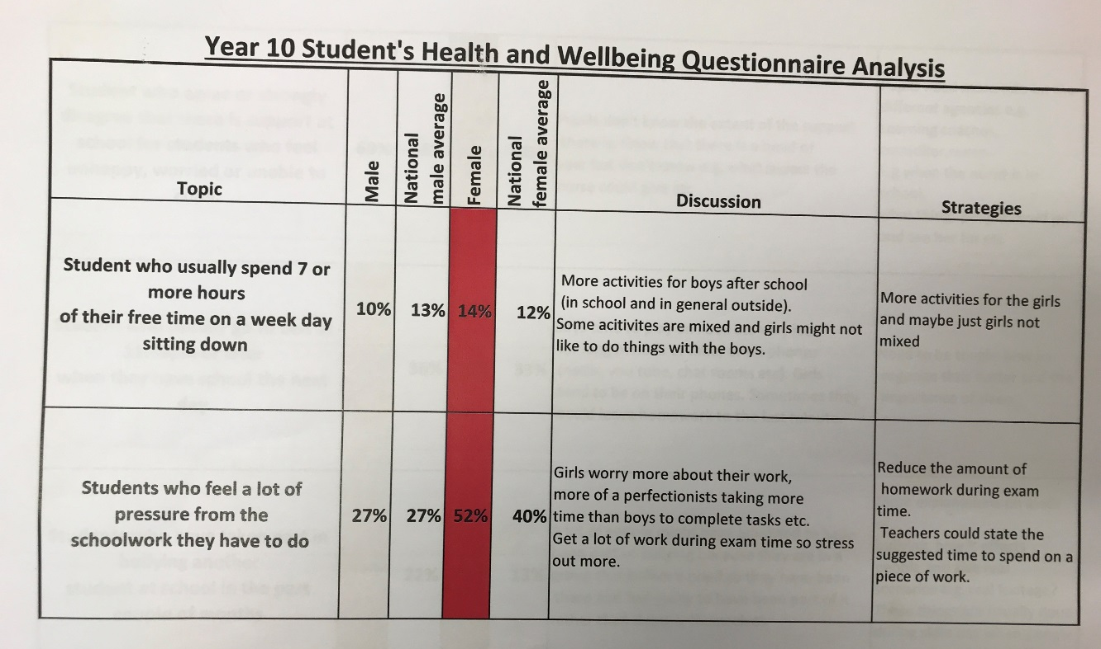

Slide 22
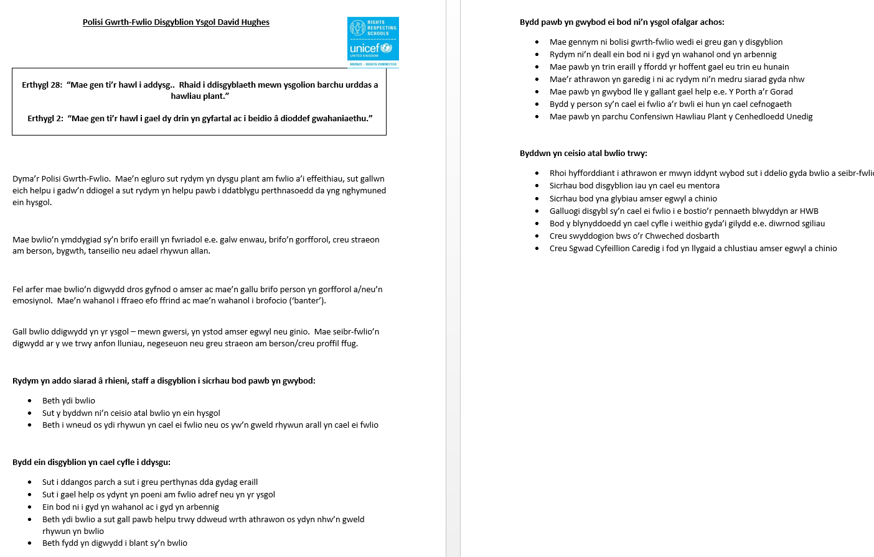
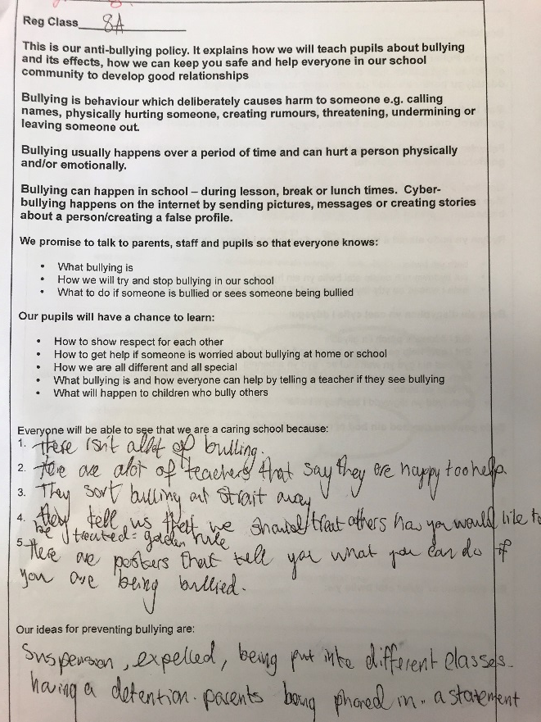

Slide 25
Blwyddyn 8
Year 8

Slide 26
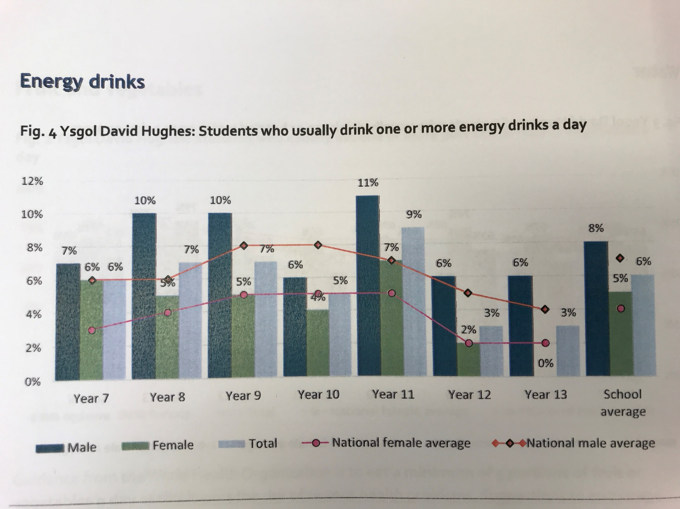
Blwyddyn 12
Year 12

