Slide 1
Flintshire & School Health Research Network
26th June 2019

Slide 2
Overview
County approach to SHRN
Alun High School
Hawarden High School
Next Steps
Notes:
Claire

Slide 3
Flintshire Approach
Notes:
Claire
Approach linking PSE / Healthy Schools / SHRN together – streamlining the three in secondary schools.
County PSE & Healthy Schools Forum

Slide 4
Flintshire Approach
Presentation at Secondary Head teachers Federation by Joan Summer 2017
All secondary schools recruited for SHRN survey and took part in Autumn 2017
School Council SHRN Workshop - April 2018
Open to all secondary school councils: how to interpret data to inform action planning. Supported by SHRN team.
Alun School pupils shared their school journey, guiding school councils in how to share their 2018 SHRN reports and develop school action plans. To be submitted by July to Flintshire.
Notes:
Claire

Slide 5
County Report
Issued November 2018
Report shared with stakeholders and across departments
82% of Flintshire pupils = 6585 total
11/11 schools (2 schools did not include year 10 and 1 school did not include year 11)
Areas of Strength | Areas for development
Water consumption Active travel Exercising vigorously Body image | Substances Sex and Relationships Bullying & cyberbullying
Notes:
Claire

Slide 6
School Council SHRN Workshop - November 2018
Supported by SHRN team, Show Racism the Red Card, The Proud Trust
Pupils shared their action plans and school priorities
Teacher SHRN workshops, themed pupil workshops
Schools identified common themes for Flintshire to prioritise
FLINTSHIRE & WREXHAM Staff Workshop - November 2018
Shared findings of both reports with PSE / healthy Schools coordinators.
Three joint areas to be prioritised are:
Summer term 2019 Energy Drinks
Autumn term 2019 Sleep
Spring Term 2020 Substances
Notes:
Claire

Slide 7
County Action Plan & Reporting
Draft SHRN County Action Plan developed Spring 2019
PSE & Healthy Schools County Forum input
Plan shared with County Emotional Health Steering Group, which includes representation from all key stakeholders
Consultation with Flintshire Youth Council representatives
Reporting to Education & Youth, Overview & Scrutiny Committee
Notes:
Claire

Slide 8
Implementing SHRN Approach into
school communities
Notes:
Emma & Darrel
Emma – Alun School has had two SHRN reports now. The school has enjoyed supporting other schools on their SHRN journey, with staff and students collaborating across schools and sharing actions.
Darrell – Having Flintshire Healthy Schools supporting SHRN across the county has been great to raise awareness and also to get the first SHRN questionnaire and report in Hawarden High School. It has given a focal point for health ad wellbeing and both adults and young people taking action in our community.

Slide 9
Alun School
and
the School Health Research Network
Notes:
Bore da, My name is Evey and here also is Sebastien and Seren.

Slide 10
School council structure at Alun School
School council
15 members (3 from each house/sixth form cabinet)
House/Sixth form cabinet
10 members
(1 from each tutor group)
Working groups:
Eco group
SNAG
Alun Diversity
Respecting Others Steering Group
PE council
Girl Up
Send my friend to school champions
Nurture
“Every child has the right to express their views, feelings and wishes in all matters affecting them.” – Article 12, UNCRC
Notes:
Evey - Pupil voice has always been the focus on using the data. When our SHRN report was released school council analysed the report and then key sections were looked at by houses who decided on key areas they would work on to raise awareness. This academic year has seen the development of a Sixth form Cabinet. The members lead sixth form projects and support working groups across the school, many of which have carried out SHRN actions.

Slide 11
2016
2016
Notes:
Seren - A summary of the report was promoted to our community as a poster. Here is our one from 2016 with key actions including hydration promotion, reduction of energy drinks and looking at stress techniques.

Slide 12
Notes:
Seb – and our 2018 summary where key actions include understanding respectful language, dealing with pressure and awareness of substances.

Slide 13
Examples from action plan drawn up in school with input from all
Indicator | Key Actions |  |  | Date
 | Student | Staff | Community
Wellbeing & Emotional Health
Sleep Fig 15 Results follow national trend for students who usually go to bed at 11.30pm or later when they have school the next day, increasing across the years. All year groups have increased since our previous report, increasing our school average from 15% to 29% with a significant jump from Y9 to 10. | Assembly on sleep organisation and techniques using drama. Sleep drop in, advice and guidance resource to access. | Staff to review PSE curriculum and themes of the week. | Community focus group on their perspective on this topic | Dec 2018
Notes:
Evey - This time round Flintshire developed an action plan format that includes key inputs from pupils, staff and the community, previously we had a few action plans whereas this one helps to track all actions in one place. We also identified the impact since the last report actions had had on pupils attitudes and behaviours.

Slide 14
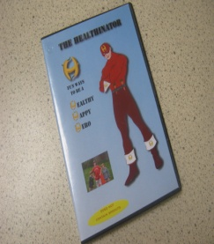
Y7 NURTURE PROJECT
SHRN Projects
Friendship &
smoking
Alcohol &
bullying
Clwyd
Dyfed
Gwent
Powys
Sleep &
Screen time
Healthy eating
& confidence
Week
Notes:
Seb - Additional themed weeks have been carried out this year and projects led by various working groups. Also the areas Houses have been working are displayed on the rights hand side.
Seren - The nurture project was led by senior students, consisting of sessions for Year 7 tutor groups, topics explored included emotions, communication and coping with pressure. Each tutor group was given a plant to look after also to highlight the importance of self care and self nurture.

Slide 15
Notes:
Evey - Since beginning our SHRN journey we have also been looking at UNCRC in more detail. It is amazing how many articles SHRN supports in the UNCRC. We are currently working towards our Gold assessment in the Autumn term.

Slide 16
Healthy Schools
Alun school and Hawarden High School has been involved in the Healthy School Scheme for many years. All actions developed as a result of the SHRN data have been considered using this approach to whole school action:
Leadership/communication
Ethos and environment
Curriculum
Family/community
In the National Quality Award assessment Alun School was praised for using the SHRN data ‘to inform and shape existing god practice and to strengthen it still further.’
Notes:
Evey - Alun school and Hawarden High School has been involved in the Healthy School Scheme for many years. All actions developed as a result of the SHRN data have been considered using this approach to whole school action:
Leadership/communication
Ethos and environment
Curriculum
Family/community
In the National Quality Award assessment Alun School was praised for using the SHRN data ‘to inform and shape existing god practice and to strengthen it still further.’
And now I will pass over to Lily from Hawarden High School.

Slide 17
SHRN in Hawarden High School
SHRN working group
(12 pupils)
Notes:
Beth – A SHRN working group was formed in response to our SHRN report where pupils who wanted to lead in the analysis and actions applied. The group consists of 12 pupils and we looked through the report identifying pros and cons. We then worked in our house groups to develop resources on key areas we identified from the report to focus on. We then presented to our headteacher and also to the school council who were impressed with the work and also the proposed actions.

Slide 18
School Council structure in Hawarden High
School council
20 members (4 from each house/sixth form)
House/Sixth form council
10 members
Working groups:
Eco group
SNAG
SHRN
Together Creating Communities
PE council
UNICEF Group
“Every child has the right to express their views, feelings and wishes in all matters affecting them.” – Article 12, UNCRC
Notes:
Henry – as you can see the SHRN group fed into school council. We listen to all perspectives and endorsed the work by the SHRN group straight away. It is great having pupil developed resources to share in our community.

Slide 19
Notes:
Beth – As Evey highlighted before the action plan format provided by Flintshire has helped to coordinate the actions across the school. It is also great to see how our voice has an impact and also how we can get involved to improve health and wellbeing.

Slide 20
Notes:
Lydia From our lists of pros and cons we produced a variety of resources for areas to focus on and identified them on a poster, along with areas to celebrate. Representatives from each house took ownership of an area to develop resources which are hyperlinked from the poster electronically: De3niol – Cannabis Glynne – Smoking Ledsham – Pressure Gladstone – Sex and Relationships. This is the poster we have put together.

Slide 21
Notes:
Lily – Gladstone developed an SRE poster to signpost pupils where they can go for advice and further information. Having posters with this content has increased conversations around school.
Beth – Deiniol house developed a poster and power point informing pupils on the impact of taking cannabis. The power point has been used in both tutor time and PSE.

Slide 22
Notes:
Lily - Ledsham house developed a poster and power point on pressure. Lots of young people experience pressure from work and having tips on how to address this is important. The school has already done a lot this year already promoting emotional wellbeing which will have a huge impact including all pupils and staff having an introduction to mindfulness.

Slide 23
Notes:
Beth – And Glynne house developed a poster and ppt on smoking to use. Although this is looked at in PSE it has been great learning about the impact in Science too.

Slide 24
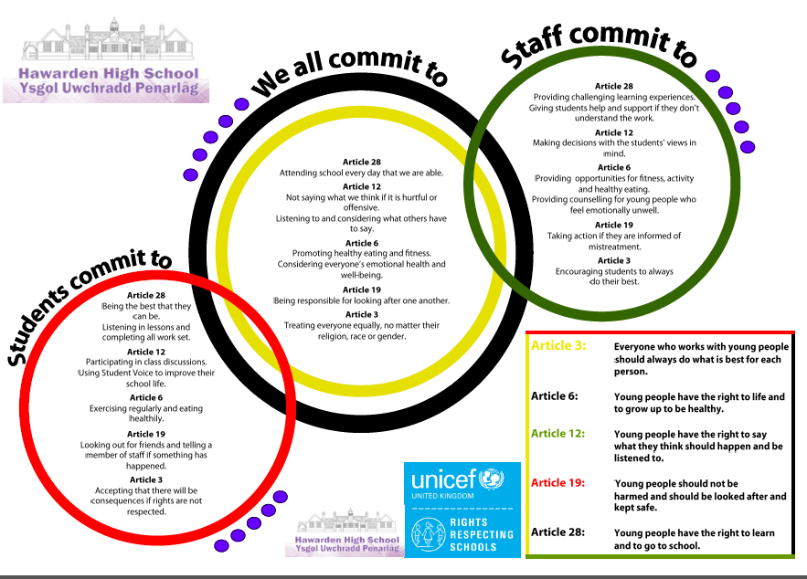
Notes:
Henry - Hawarden High School are also on their Rights Respecting schools journey, currently working towards Silver. Having a SHRN report has has supported our understanding of our rights. We are listened to in our school and community and appreciate how school staff and County Council staff are using the data to develop health and wellbeing.

Slide 25
The Five Ways
to Wellbeing
Notes:
Evey - Moving forwards and awaiting the completion of the next SHRN questionnaire in the Autumn term Alun School and Hawarden High are collaborating over two projects. You may have picked them up through the presentation.
Henry - Firstly –the 5 ways to wellbeing – both schools have looked at this as a tool for dealing with pressure and promoting wellbeing – we are both implementing this as a whole school initiative and piloting individual wellbeing audits for pupils along with wellbeing goal setting, helping develop resources and roll the iniative out.
Evey – Secondly, Rights Respecting Schools. It has been great sharing our understanding and approaches to UNCRC. Going forward as SHRN supports so many rights mapping the rights across SHRN promotion and projects we carry out seems like the natural next step.
Thank you for listening and

Slide 26
Summary
Pupil Voice
Partnership Working
Coordinated Approach
Next Steps
Finalise action plan & implement
Ongoing engagement with Youth Council
Maximise participation in SHRN Survey 2019
Further School Council workshops & activities
Notes:
Claire

Slide 27
Notes:
Claire
Any questions

