Slide 1
Digital Dashboard for Student Health
Dr Jeremy Segrott, Dr Hayley Reed, and Dr Nick Page

Slide 2
Project Overview Aim: To develop a digital dashboard for school staff to access their schools SHRN data Method: User Centered Tool Design through cycles of involvement
Generation 1
Who: Focus groups with school staff and pupils and consultation with two young people's groups.
How: Shown data dashboards to critique and consider functionality and usability of SHRN school dashboard.
Generation 2
Who: SHRN school staff
How: Workshop session to feedback on the mock-ups and raise any further content ideas.
Generation 3
Who: Health Schools Coordinators, WSA Implementation coordinators; school staff; young people.
How: Workshops to feedback on coded prototype.
Output: Mockups of dashboard.
Output: Coded Prototype
Output: Refined Coded Prototype
Notes:
Generation 1: 10 staff in three focus groups. 14 pupils in two focus groups. ALPHA (n= 4) and Wolfson Groups (n= 9)

Slide 3
Guided tour of the dashboard
Key Questions
What do you think of the proposed dashboard structure?
What do you think of the proposed dashboard functionality?
Any additional value-added content/functionality needed?
Notes:
Functionality - Whilst we already have data on this from DataMind and YPAG's would be good to start with what we think the additional functionality could be – cross tabs and longitudinal data.
Structure/aesthetic - Including do they want tabs by health topic or by function?

Slide 4
Landing page (secure login)

Slide 5
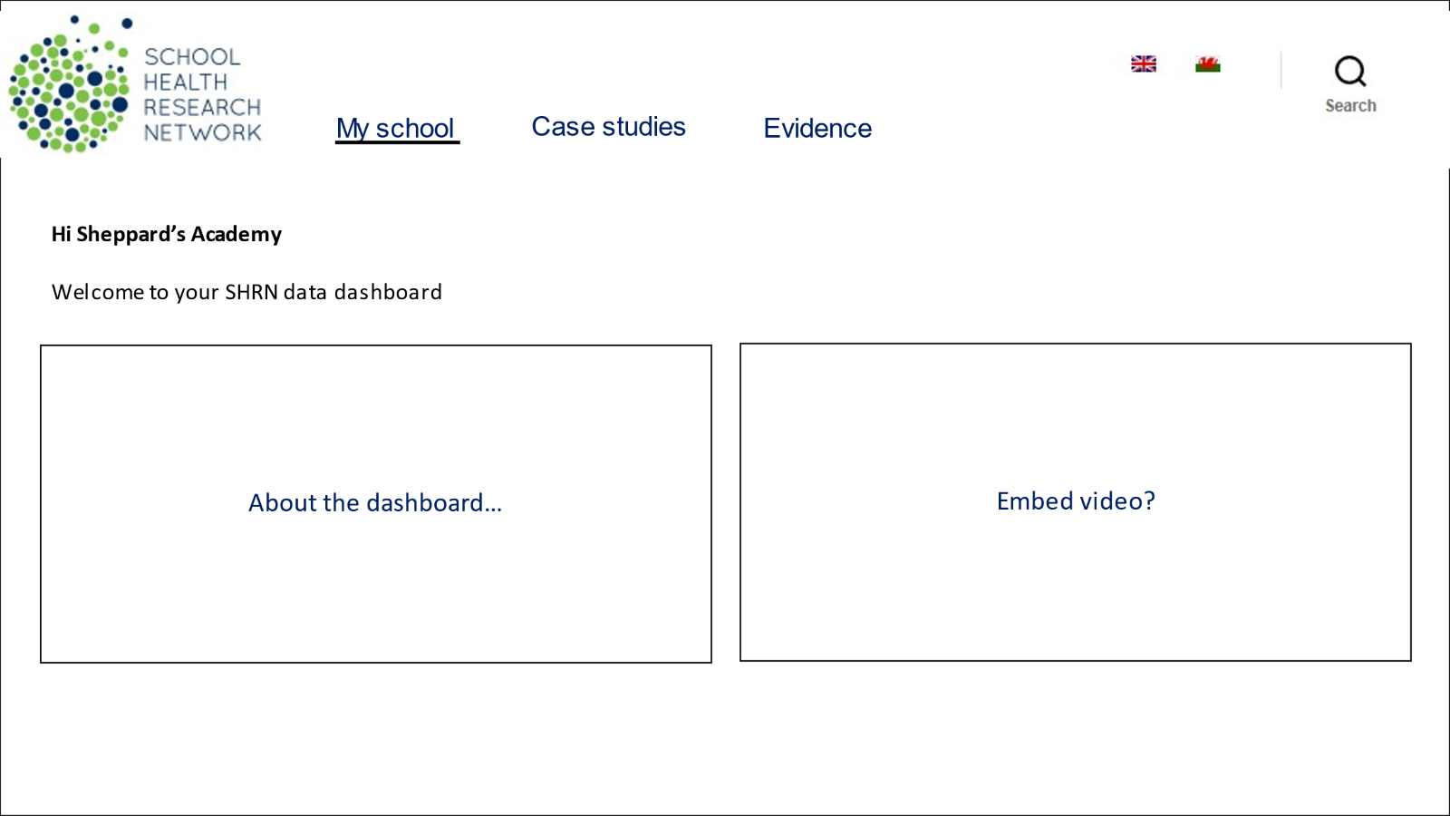
School level data tab – 1 (top of page)

Slide 6
School level data – 2 (middle of page)

Slide 7
School level data – 3 (bottom of page)

Slide 8
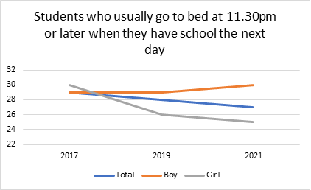
School averages across multiple survey years

Slide 9
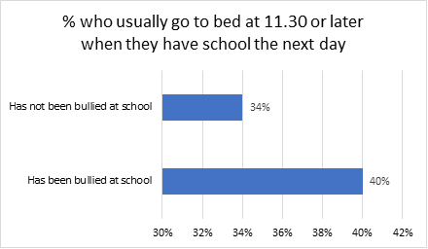
Single year cross-tabulations between selected variables (e.g. bullying and sleep)

Slide 10
Case study tab

Slide 11
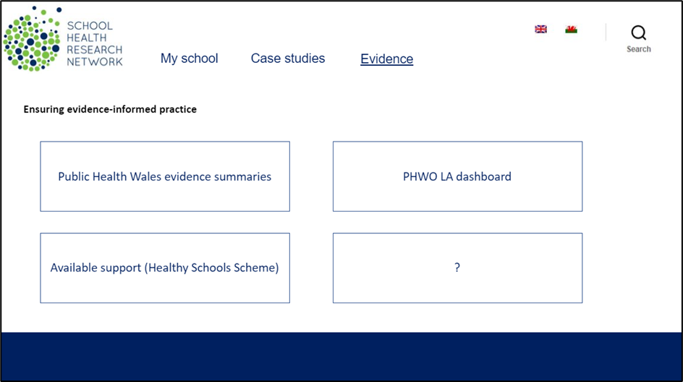
Evidence tab

Slide 12
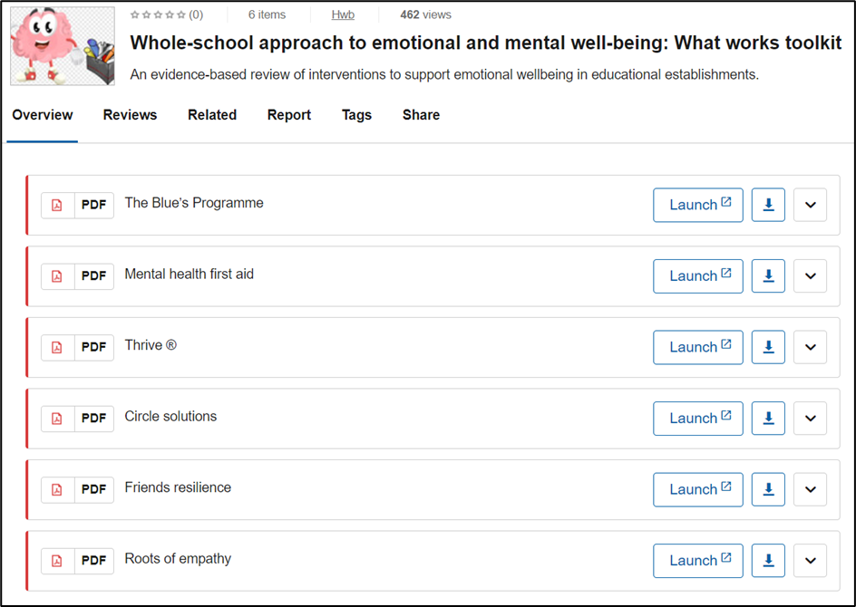
PHW evidence summaries (Hwb)

Slide 13
Task – 10 mins
At your tables, please use the paper provided to feedback views on what you like / dislike about the following:
Dashboard structure
Dashboard functionality
And consider what content / functions could offer additional value
Dashboard additions

Slide 14
Future Dashboard Development We are looking for staff members to take part in focus groups over the summer to test the first digital prototype. Focus groups will be on-line and between 1-2 hours. All staff will be offered a £50 Amazon voucher for taking part. If you would like to take part please contact Dr Hayley Reed on reedhm@cardiff.ac.uk.

